Slide 1


Social Networking
A Parents Guide

Slide 2

Social Networking Sites:
What Are They?
Social networking refers to a community where one connects and communicates with others on the Internet. Although the actual format may vary from website to website, communication is accomplished using a variety of methods, such as web logs or “blogs, instant messaging, email, video, chat rooms or forums

Slide 3




Social Networking Sites:

Slide 4

Is it not illegal for an under 13 year old to have an account, but it is against most usage policies. If discovered the account is terminated and the email address used black listed.

Slide 5




Access To Social Networking Sites
Smart Phones
Handheld consoles
Games Consoles
Computers

Slide 6

Not Forgetting
Tablets

Slide 7

Number One Safeguarding Tip:
Place the computer central in the house,
with the screen facing in to the room.

Slide 8
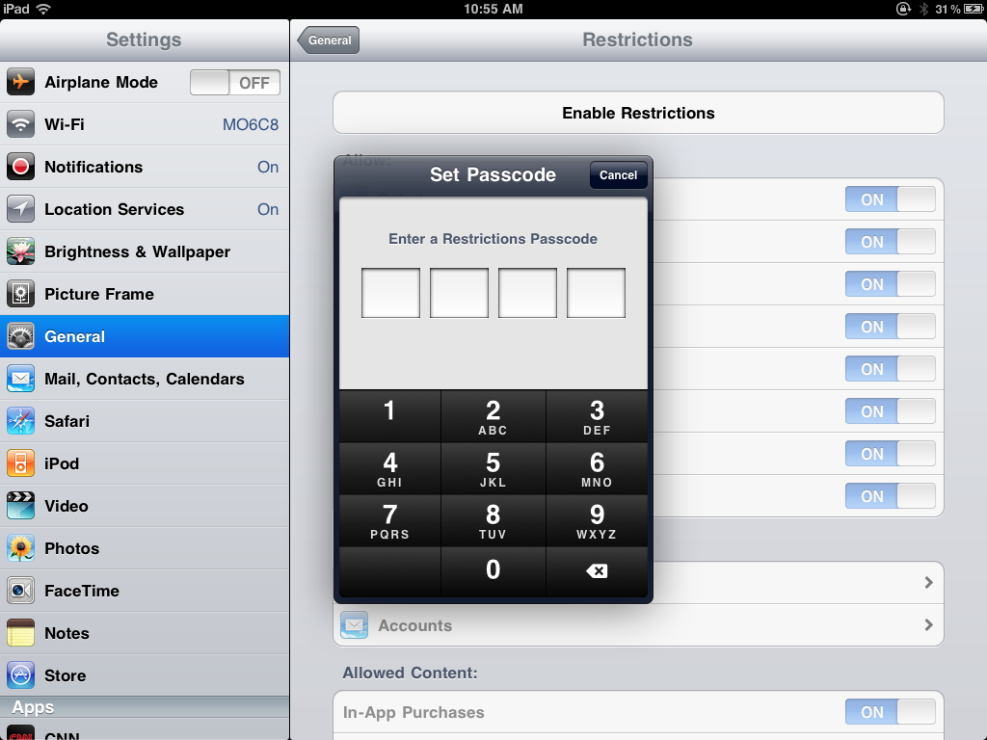
On mobile devices use the restrictions so that you are in control

Slide 9

Becoming Cyber-savvy
One in four children use slang to hide their online activities from their parents.

Slide 10
Some Common Terms Used
MOS
- Mum Over Shoulder
PAW
- Parents Are Watching
Code 9
- Parents Are Around

Slide 11
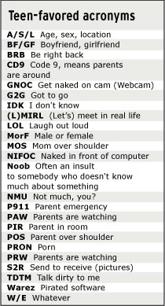


Slide 12
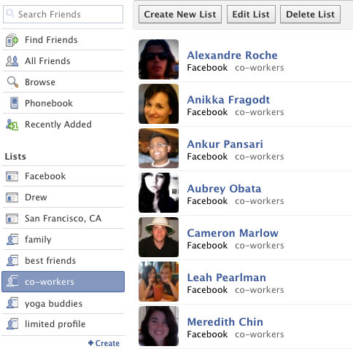
Befriend Your Child
Join the same social networking site and ask your child to add you as a friend. By doing so you can monitor what they are posting.

Slide 13

Privacy Settings
Insist that your child has their privacy settings set to high

Slide 14

Turn Off Geo-location
Some social networks will post the geographic location of the message sender. Make sure your child has turned this option off.

Slide 15

Talk To Your Child
Discuss with your child what they are doing to remain safe online.

Slide 16
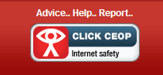
Reporting Issues
If you have any concerns regarding your child’s activities contact ‘The Child Exploitation and Online Protection ‘ (CEOP)website.
www.ceop.gov.uk

Slide 17

Record Any Evidence
If you have concerns about an online conversation or social network posting save the evidence. The police will be able to use it if further action is required.

Slide 18
Useful Websites
www.saferinternet.org.uk/
www.swgfl.org.uk/Staying-Safe
http://www.childnet.com/kia/parents/
www.thinkuknow.co.uk/parents/browser-safety/

